Slide 2
WHO WE ARE
Website Development & Design
Web Marketing Strategy, Training, and Analysis
Web Applications, iOS apps, Android apps

Slide 3
WHO WE ARE
Website Development & Design
Web Marketing Strategy, Training, and Analysis
Web Applications, iOS apps, Android apps

Slide 5
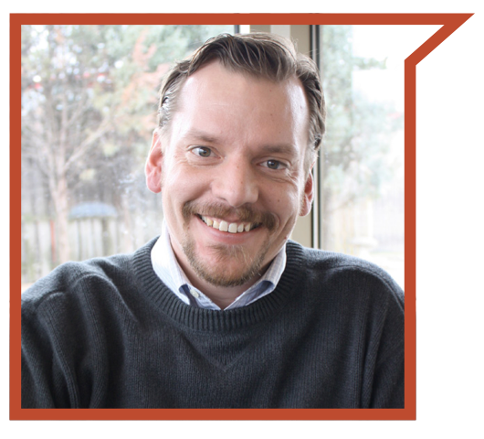
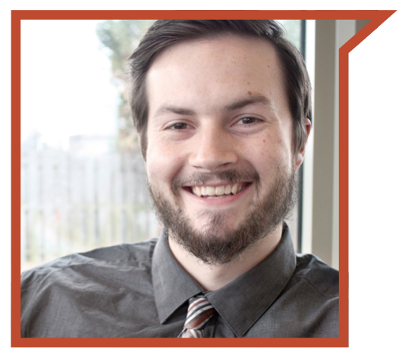
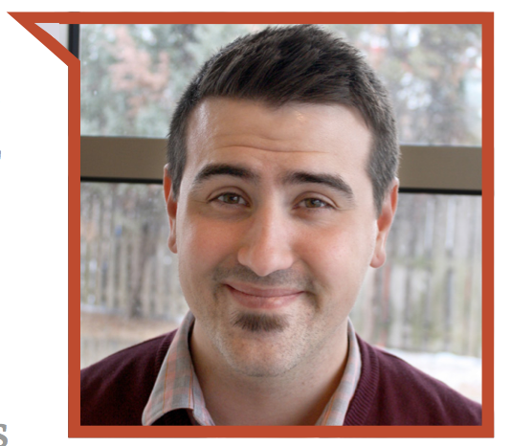
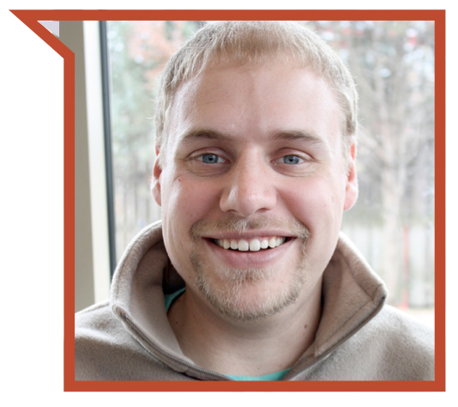
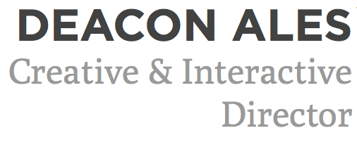
The Digital Solutions Management Team

Slide 6
WHY DIGITAL SOLUTIONS
Notes:
*Hit on each of the points with a brief explanation*

Slide 7
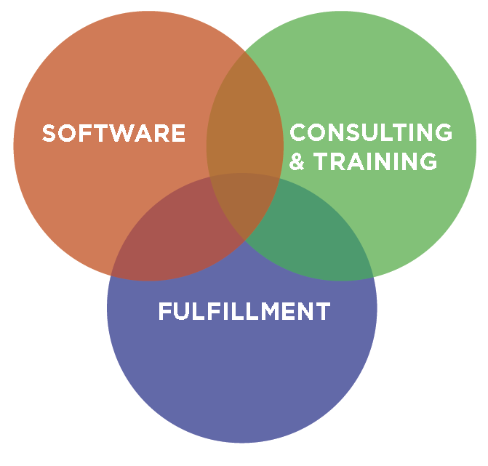
WHY DIGITAL SOLUTIONS
Notes:
*Hit on each of the points with a brief explanation*

Slide 8
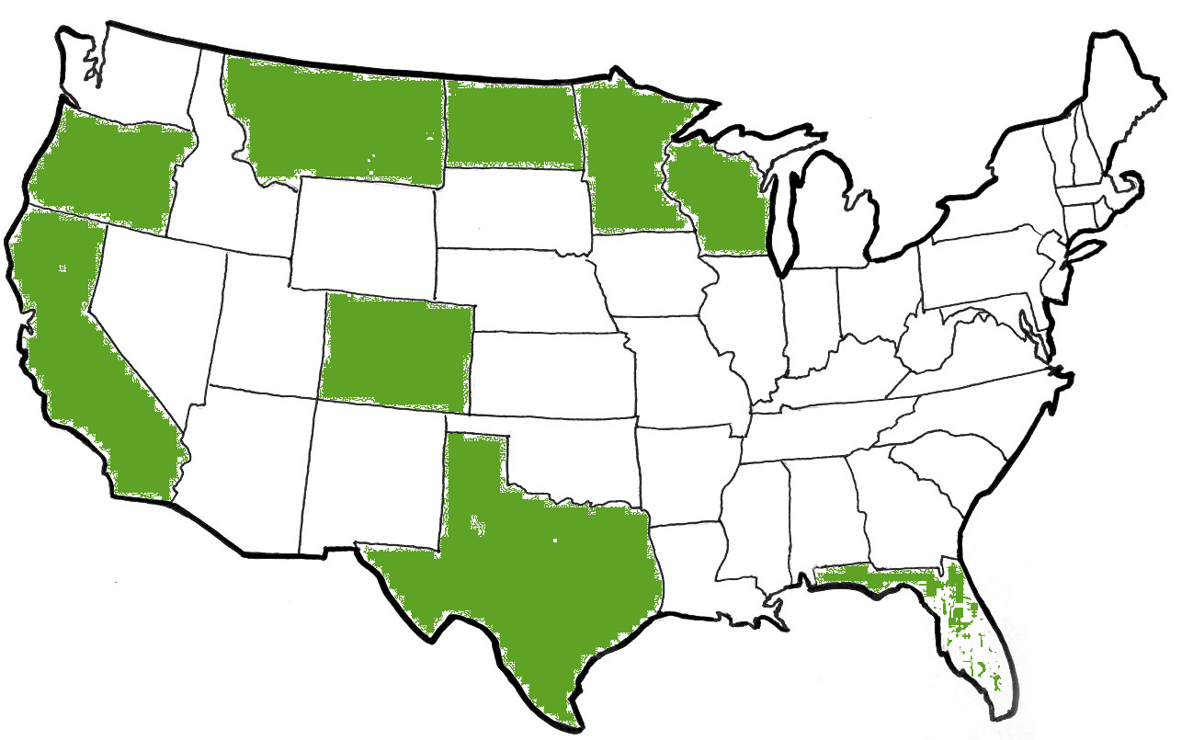
Clients in 9 States :: Software Users in 41
Notes:
*Hit on each of the points with a brief explanation*

Slide 9
Marc Ohmann
Born, Raised and Live in Bloomington
U of M Computer Science and Engineering
15 Years Running Digital Solutions
Wife (Angie), Daughter and Two Sons
Notes:
These facts are some of the driving forces behind why Digital Solutions exists. With billions of google searches every day, there are huge opportunities to be capitalized on regardless of your industry.

Slide 10
WHERE ARE WE GOING?
Overview of Internet Marketing Today

Slide 11
WHERE ARE WE GOING?
Overview of Internet Marketing Today
How Google AdWords Fits

Slide 12
WHERE ARE WE GOING?
Overview of Internet Marketing Today
How Google AdWords Fits
Case Study

Slide 13
WHERE ARE WE GOING?
Overview of Internet Marketing Today
How Google AdWords Fits
Case Study
Q & A

Slide 14
Are you ready for a quick QUIZ?

Slide 15
Do growing companies invest heavily in SALES?

Slide 16
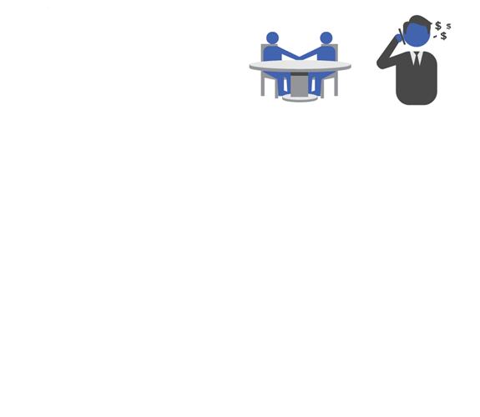
Do growing companies invest heavily in RELATIONSHIPS?

Slide 17
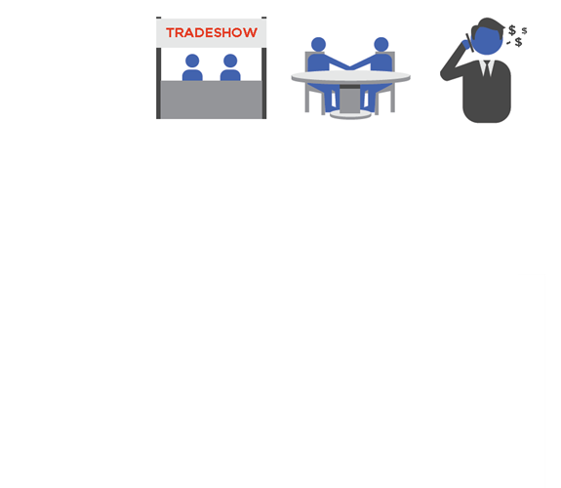
Do growing companies invest heavily in VISIBILITY?

Slide 18
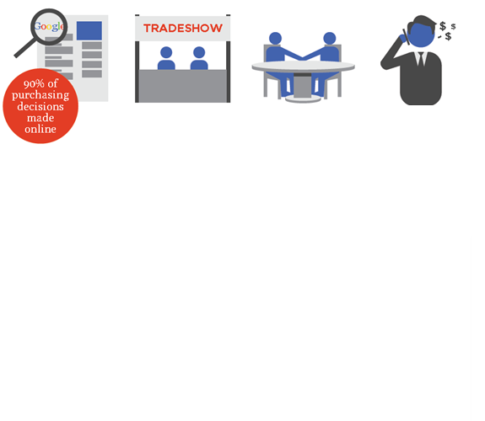
Do growing companies invest heavily in GETTING FOUND?

Slide 19
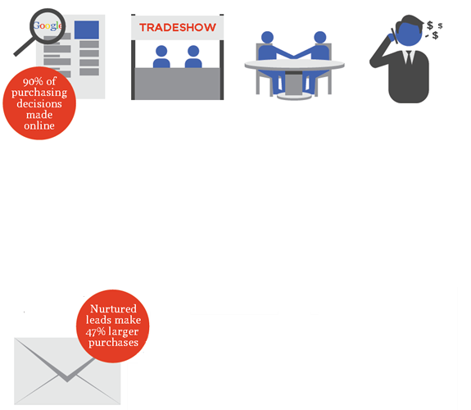
Do growing companies invest in NURTURING LEADS?

Slide 20
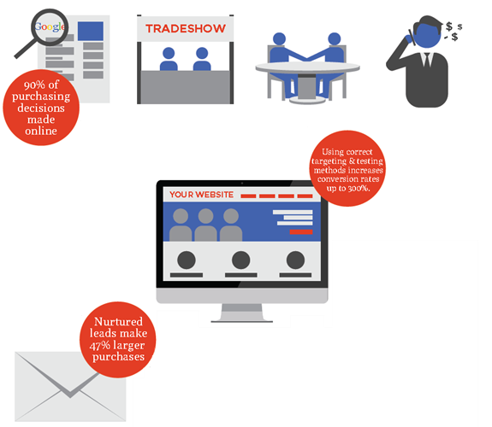
Do growing companies invest heavily in WEBSITES?

Slide 21
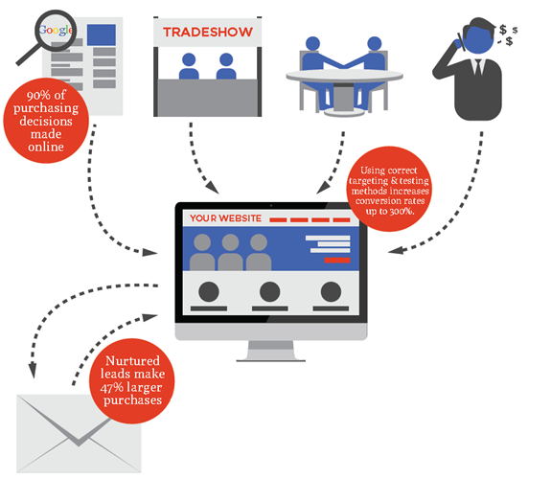
At the center of it all is the WEBSITE

Slide 22
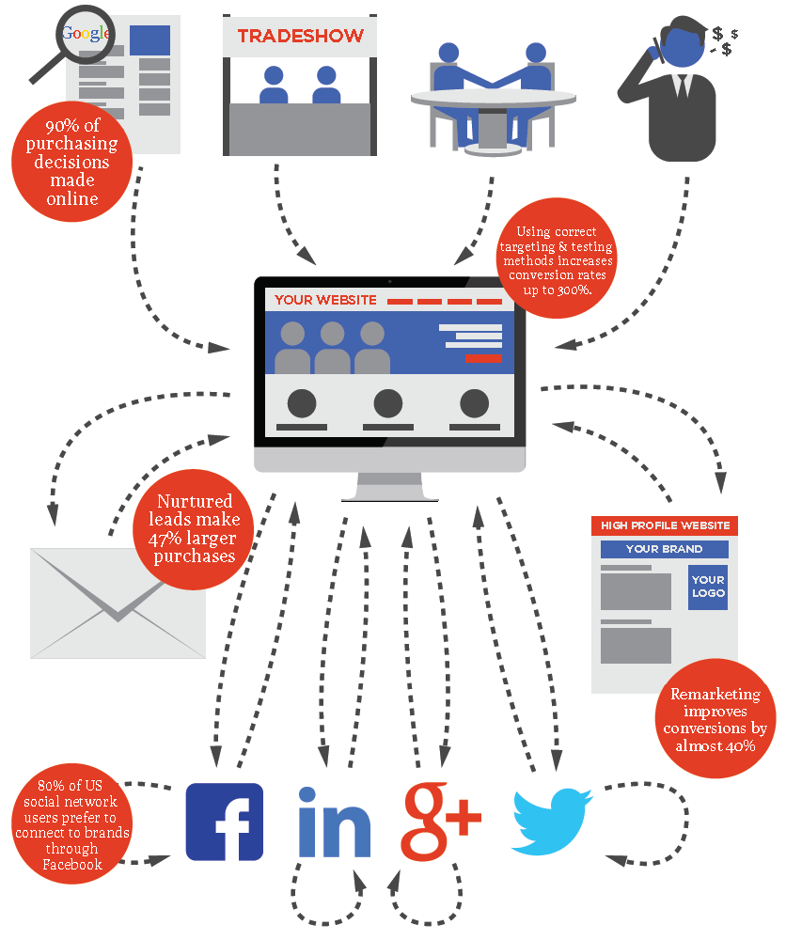

Slide 23
Websites and your presence online are measured by three metrics:

Slide 24
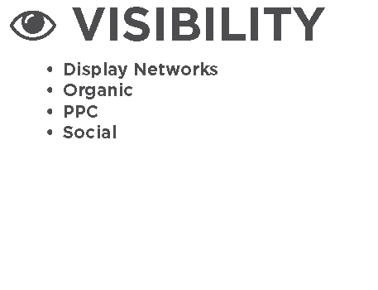
Websites and your presence online are measured by three metrics:

Slide 25
Websites and your presence online are measured by three metrics:

Slide 26
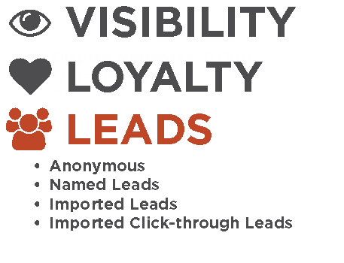
Websites and your presence online are measured by three metrics:

Slide 27
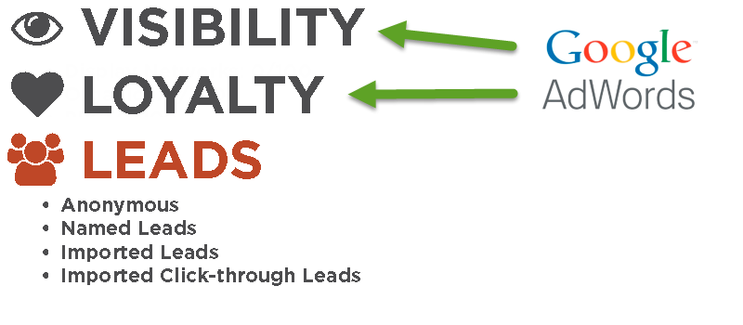
Websites and your presence online are measured by three metrics:

Slide 28
WHAT IS ADWORDS?

Slide 29
ADWORDS IS:
AdWords offers pay-per-click (PPC), that is, cost-per-click (CPC) advertising, cost-per-thousand-impressions or cost per mille (CPM) advertising, site-targeted advertising for text, banner, and rich-media ads, and remarketing.

Slide 30
ADWORDS IS:
AdWords offers pay-per-click (PPC), that is, cost-per-click (CPC) advertising, cost-per-thousand-impressions or cost per mille (CPM) advertising, site-targeted advertising for text, banner, and rich-media ads, and remarketing.
Of $55.5 billion in revenue $50.5 billion is from AdWords (91%)

Slide 31
ADWORDS IS:
AdWords offers pay-per-click (PPC), that is, cost-per-click (CPC) advertising, cost-per-thousand-impressions or cost per mille (CPM) advertising, site-targeted advertising for text, banner, and rich-media ads, and remarketing.
Of $55.5 billion in revenue $50.5 billion is from AdWords (91%)
Only pay for clicks

Slide 32
ADWORDS IS:
AdWords offers pay-per-click (PPC), that is, cost-per-click (CPC) advertising, cost-per-thousand-impressions or cost per mille (CPM) advertising, site-targeted advertising for text, banner, and rich-media ads, and remarketing.
Of $55.5 billion in revenue $50.5 billion is from AdWords (91%)
Only pay for clicks
Google manages display and budget

Slide 33
ADWORDS IS:
AdWords offers pay-per-click (PPC), that is, cost-per-click (CPC) advertising, cost-per-thousand-impressions or cost per mille (CPM) advertising, site-targeted advertising for text, banner, and rich-media ads, and remarketing.
Of $55.5 billion in revenue $50.5 billion is from AdWords (91%)
Only pay for clicks
Google manages display and budget
Quality score matters

Slide 34
ADWORDS IS:
AdWords offers pay-per-click (PPC), that is, cost-per-click (CPC) advertising, cost-per-thousand-impressions or cost per mille (CPM) advertising, site-targeted advertising for text, banner, and rich-media ads, and remarketing.
Of $55.5 billion in revenue $50.5 billion is from AdWords (91%)
Only pay for clicks
Google manages display and budget
Quality score matters
Quickest way to lose $10k

Slide 35
ADWORDS IS:
AdWords offers pay-per-click (PPC), that is, cost-per-click (CPC) advertising, cost-per-thousand-impressions or cost per mille (CPM) advertising, site-targeted advertising for text, banner, and rich-media ads, and remarketing.
Of $55.5 billion in revenue $50.5 billion is from AdWords (91%)
Only pay for clicks
Google manages display and budget
Quality score matters
Quickest way to lose $10k
The Quickest way to make $10k

Slide 36
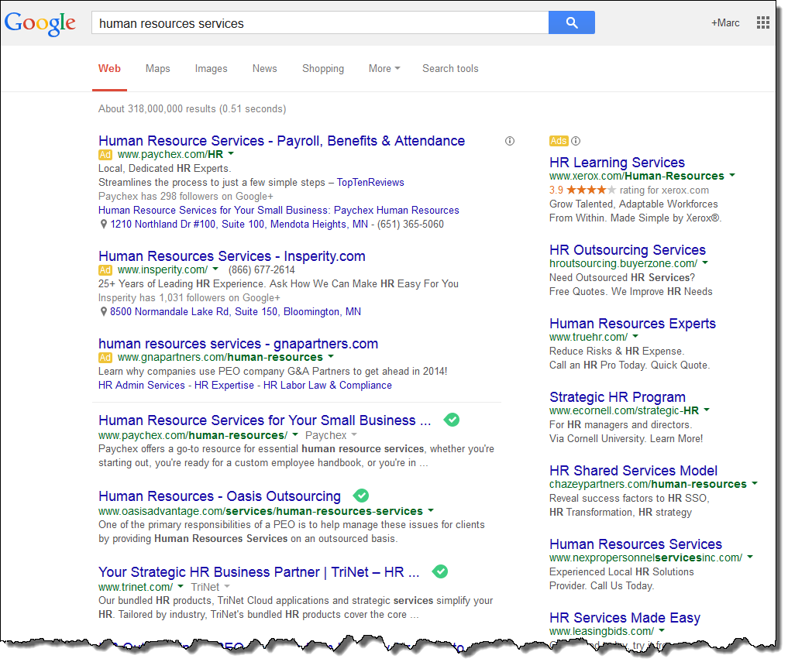
WHAT IS ADWORDS?

Slide 37
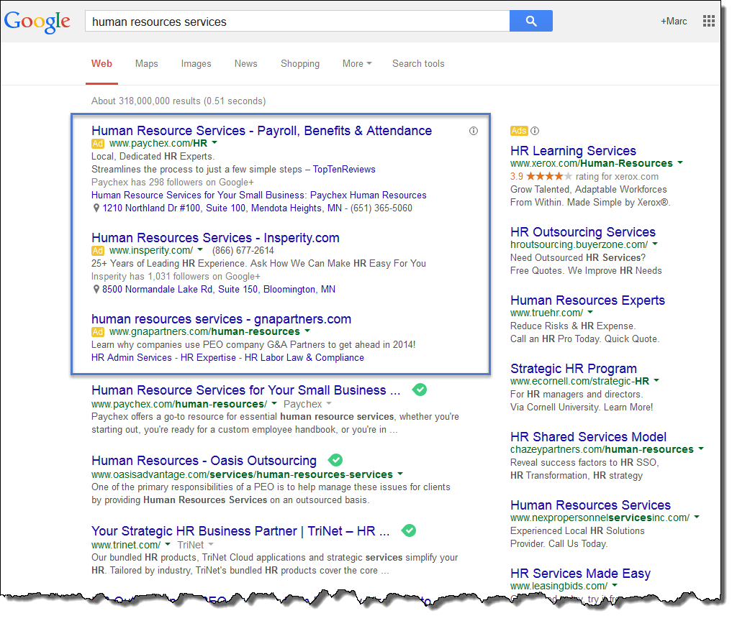
WHAT IS ADWORDS?

Slide 38
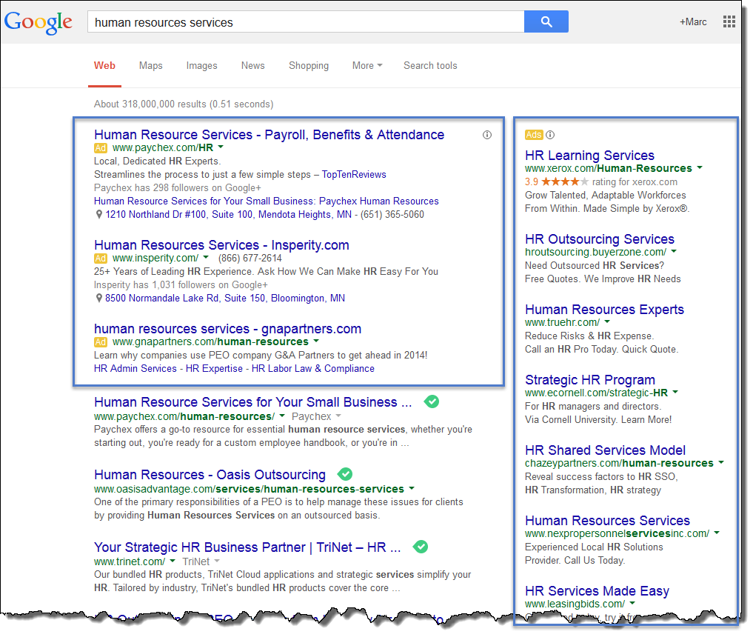
WHAT IS ADWORDS?

Slide 39
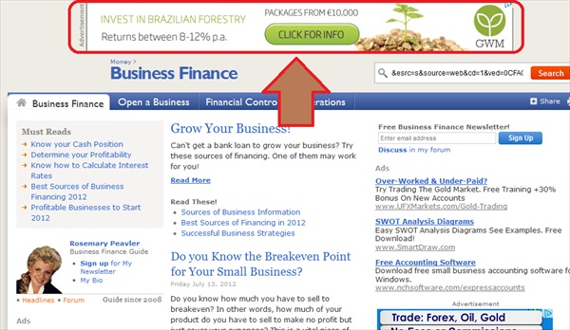
WHAT IS ADWORDS?

Slide 40
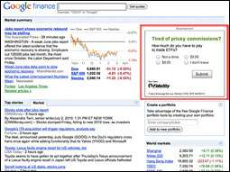
WHAT IS ADWORDS?

Slide 41
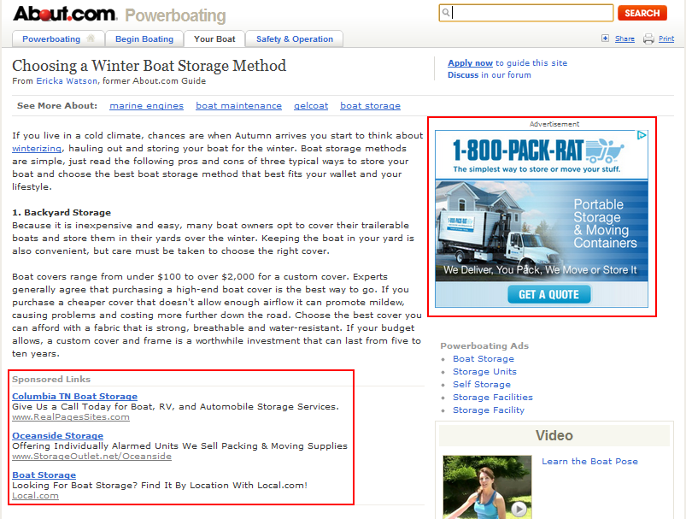
WHAT IS ADWORDS?

Slide 42
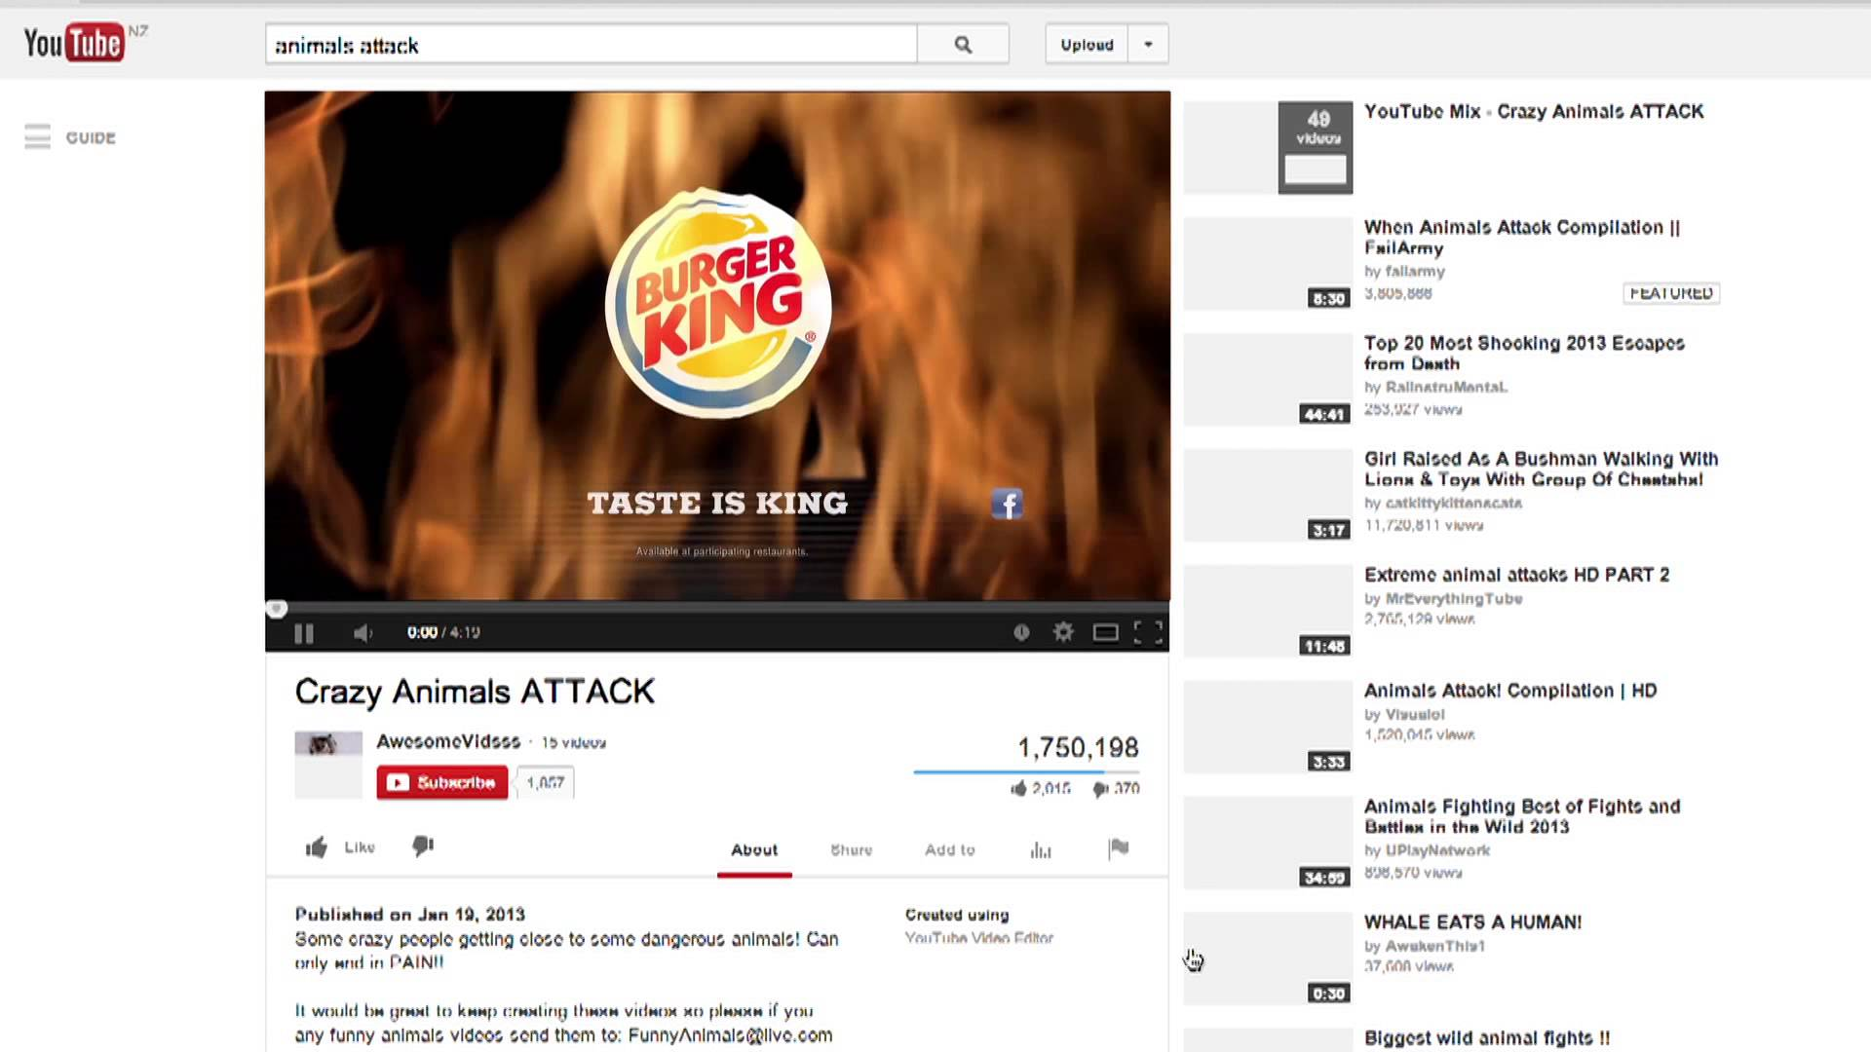
WHAT IS ADWORDS?

Slide 43
ADWORDS IS:
Targeted Visibility

Slide 44
ADWORDS IS:
Targeted Visibility By
Search phrases

Slide 45
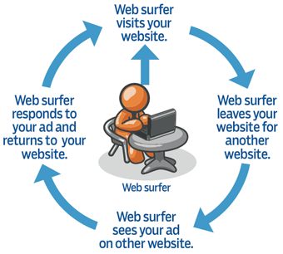
ADWORDS IS:
Targeted Visibility By
Search phrases
Browsing habits (Retargeting)

Slide 46
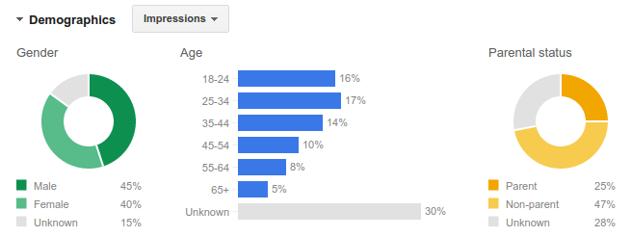
ADWORDS IS:
Targeted Visibility By
Search phrases
Browsing habits (Retargeting)
Demographics

Slide 47
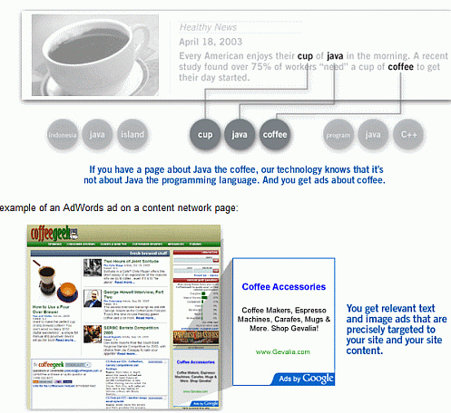
ADWORDS IS:
Targeted Visibility By
Search phrases
Browsing habits (Retargeting)
Demographics
Content being viewed

Slide 48
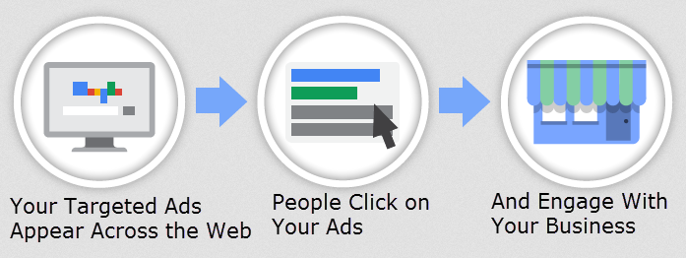
IN ESSENCE ADWORDS IS:

Slide 49
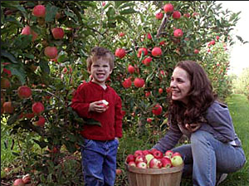
CASE STUDY
Cheryl runs Happy Orchards Apples
She has invested her life savings into these trees
Summer rains brought a record harvest!
Cheryl needs more customers
Cheryl’s Brother-in-law Recommends AdWords
Cheryl Creates her first AdWords campaign!

Slide 50
CASE STUDY
Cheryl finds plenty of people searching for her products

Slide 51
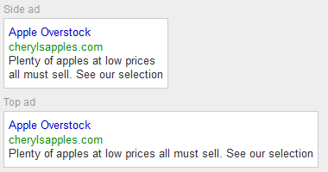
CASE STUDY
Cheryl creates some ads

Slide 52
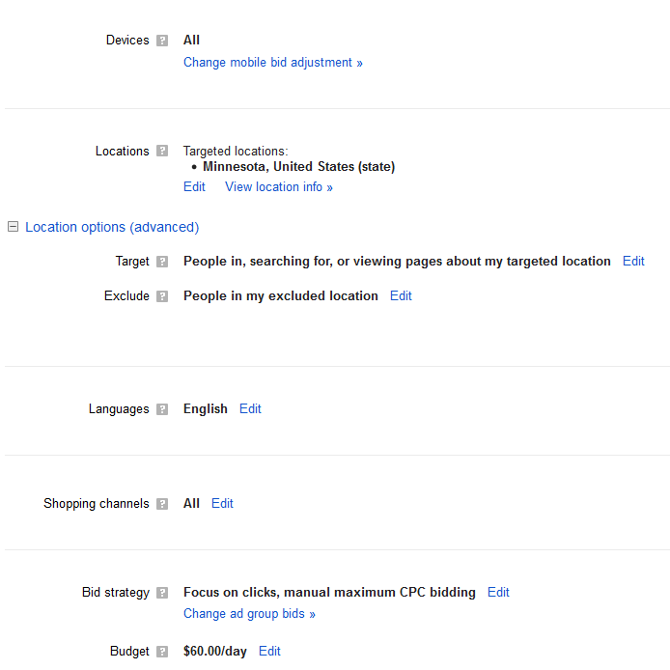
CASE STUDY
Cheryl sets a daily budget

Slide 53
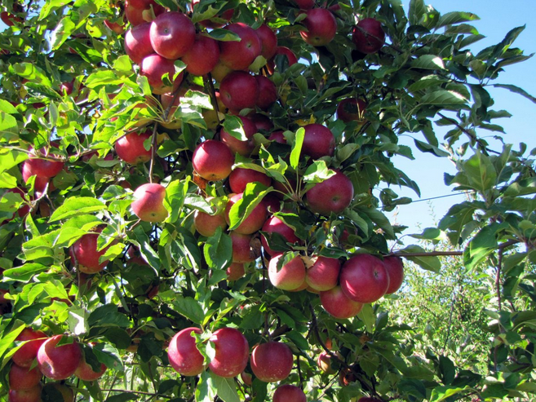
CASE STUDY
Cheryl goes back to picking, cleaning, sorting, bagging and selling apples.

Slide 54
CASE STUDY
Traffic to Cherly’s Website is up over 300%

Slide 55
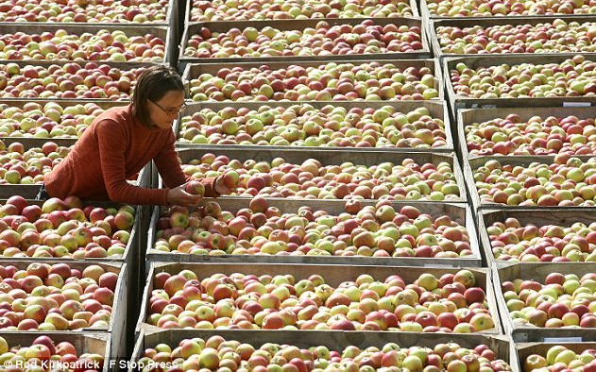
CASE STUDY
But Something Doesn’t Seem Right

Slide 56
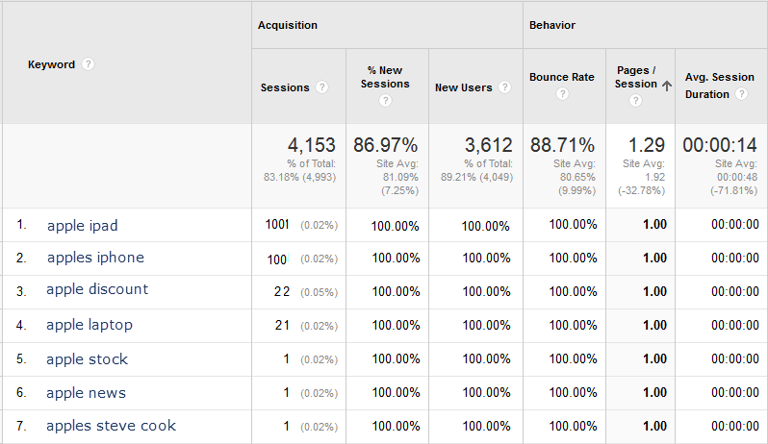
CASE STUDY
Traffic to Cherly’s Website is up over 300%

Slide 57
CASE STUDY
What did Cheryl do wrong?
Negative Keywords

Slide 58
CASE STUDY
What did Cheryl do wrong?
Negative Keywords
Mobile Devices

Slide 59
CASE STUDY
What did Cheryl do wrong?
Negative Keywords
Mobile Devices
Search and Display Networks

Slide 60
CASE STUDY
What did Cheryl do wrong?
Negative Keywords
Mobile Devices
Search and Display Networks
Constant Monitoring (keywords, bidding, ad copy, …)

Slide 61
CASE STUDY
What did Cheryl do wrong?
Negative Keywords
Mobile Devices
Search and Display Networks
Constant Monitoring (keywords, bidding, ad copy, …)
Conversion Optimization

Slide 62
CASE STUDY
What did Cheryl do wrong?
Negative Keywords
Mobile Devices
Search and Display Networks
Constant Monitoring (keywords, bidding, ad copy, …)
Conversion Optimization
Lead Tracking

Slide 63
CASE STUDY
What did Cheryl do wrong?
Negative Keywords
Mobile Devices
Search and Display Networks
Constant Monitoring (keywords, bidding, ad copy, …)
Conversion Optimization
Lead Tracking
Total loss $1,800 over 1 month

Slide 64
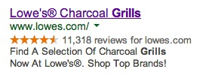
GREAT ADS
Linked closely to keywords

Slide 65
GREAT ADS
Linked closely to keywords
Contain a call to action

Slide 66
GREAT ADS
Linked closely to keywords
Contain a call to action
Limit risk for buyer

Slide 67
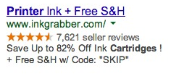
GREAT ADS
Linked closely to keywords
Contain a call to action
Limit risk for buyer
Use precise numbers

Slide 68
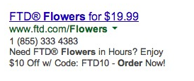
GREAT ADS
Linked closely to keywords
Contain a call to action
Limit risk for buyer
Use precise numbers
Use funny characters

Slide 69
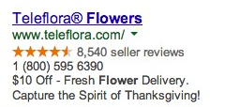
GREAT ADS
Linked closely to keywords
Contain a call to action
Limit risk for buyer
Use precise numbers
Use funny characters
Include the benefit

Slide 70
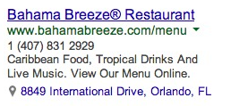
GREAT ADS
Linked closely to keywords
Contain a call to action
Limit risk for buyer
Use precise numbers
Use funny characters
Include the benefit
Contain Name, Address and Phone when local

Slide 71
TIPS TO SAVE BUDGET
Negative Keywords

Slide 72
TIPS TO SAVE BUDGET
Negative Keywords
Scheduling Ads

Slide 73
TIPS TO SAVE BUDGET
Negative Keywords
Scheduling Ads
Split Tests

Slide 74
TIPS TO SAVE BUDGET
Negative Keywords
Scheduling Ads
Split Tests
Match Types

Slide 75
TIPS TO SAVE BUDGET
Negative Keywords
Scheduling Ads
Split Tests
Match Types
Quality Score

Slide 76
TIPS TO SAVE BUDGET
Negative Keywords
Scheduling Ads
Split Tests
Match Types
Quality Score
Networks

Slide 77
TIPS TO SAVE BUDGET
Negative Keywords
Scheduling Ads
Split Tests
Match Types
Quality Score
Networks
Mobile Search

Slide 78
TIPS TO SAVE BUDGET
Negative Keywords
Scheduling Ads
Split Tests
Match Types
Quality Score
Networks
Mobile Search
Languages

Slide 79
TIPS TO SAVE BUDGET
Negative Keywords
Scheduling Ads
Split Tests
Match Types
Quality Score
Networks
Mobile Search
Languages
Bounce Rate

Slide 80
TIPS TO SAVE BUDGET
Negative Keywords
Scheduling Ads
Split Tests
Match Types
Quality Score
Networks
Mobile Search
Languages
Bounce Rate
Location Targeting

Slide 81
TIPS TO SAVE BUDGET
Negative Keywords
Scheduling Ads
Split Tests
Match Types
Quality Score
Networks
Mobile Search
Languages
Bounce Rate
Location Targeting
Remarketing

Slide 82
LEAD TRACKING ALLOWS:
Seeing not only what visits happened on your site but WHO visited

Slide 83
LEAD TRACKING ALLOWS:
Seeing not only what visits happened on your site but WHO visited
Viewing all data collected on a lead in one location

Slide 84
LEAD TRACKING ALLOWS:
Seeing not only what visits happened on your site but WHO visited
Viewing all data collected on a lead in one location
Seeing which channels drive not only the most traffic but the traffic that turns into customers

Slide 85
LEAD TRACKING ALLOWS:
Seeing not only what visits happened on your site but WHO visited
Viewing all data collected on a lead in one location
Seeing which channels drive not only the most traffic but the traffic that turns into customers
Seeing what social media accounts visitors to your site use

Slide 86
LEAD TRACKING ALLOWS:
Seeing not only what visits happened on your site but WHO visited
Viewing all data collected on a lead in one location
Seeing which channels drive not only the most traffic but the traffic that turns into customers
Seeing what social media accounts they are on
Seeing which of your YouTube videos a prospect has watched

Slide 87
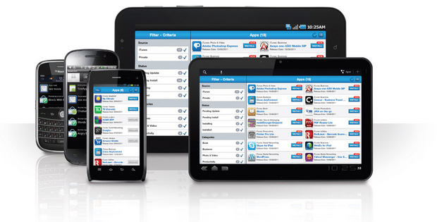
LEAD TRACKING ALLOWS:
Seeing not only what visits happened on your site but WHO visited
Viewing all data collected on a lead in one location
Seeing which channels drive not only the most traffic but the traffic that turns into customers
Seeing what social media accounts they are on
Seeing which of your YouTube videos a prospect has watched
Seeing a full history across all their devices of what actions a prospect has taken on your website

Slide 88
LEAD TRACKING ALLOWS:
Seeing not only what visits happened on your site but WHO visited
Viewing all data collected on a lead in one location
Seeing which channels drive not only the most traffic but the traffic that turns into customers
Seeing what social media accounts they are on
Seeing which of your YouTube videos a prospect has watched
Seeing a full history across all their devices of what actions a prospect has taken on your website
Seeing what influence they have online and how you can most easily engage with them

Slide 89
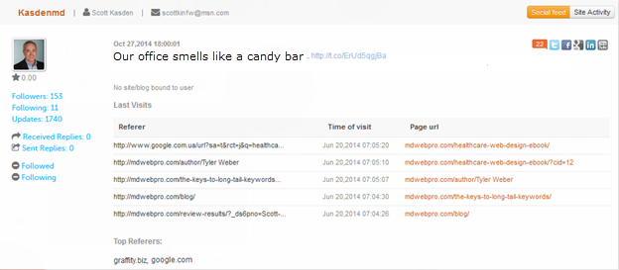
LEAD TRACKING

Slide 90
SUMMARY:
AdWords is the easiest/quickest method to increase visibility
AdWords is the easiest/quickest method to lose $10,000
AdWords is the easiest/quickest method to make $10,000
Think holistically about your marketing to gain the most benefit

Slide 91
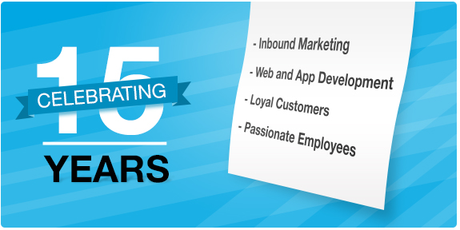
Thank You! Questions?

